Slide 1
BTT Recorder v1.4
Editing
Recordings
Cutting
Inserting

Slide 2
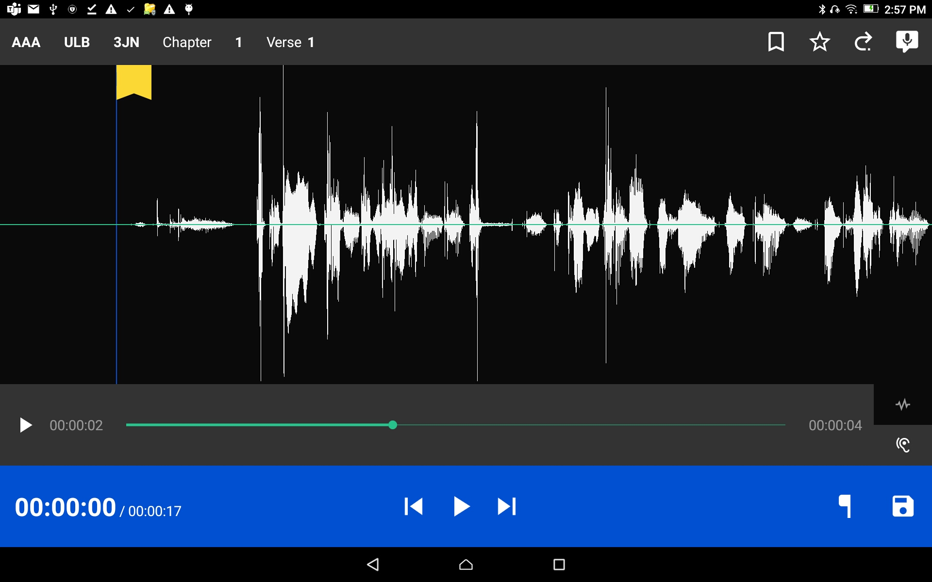

Compare Recording to Source Audio Play the source audio
Tap on the hearing icon
and press the play icon.
Listen to the source audio.

Slide 3
Compare Recording to Source Audio Play the source audio
To rewind (go towards the beginning of the recording)
or fast forward (go towards the end of the recording)
press and hold the green dot and slide your finger to the left for rewind or to the right to fast forward.

Slide 4
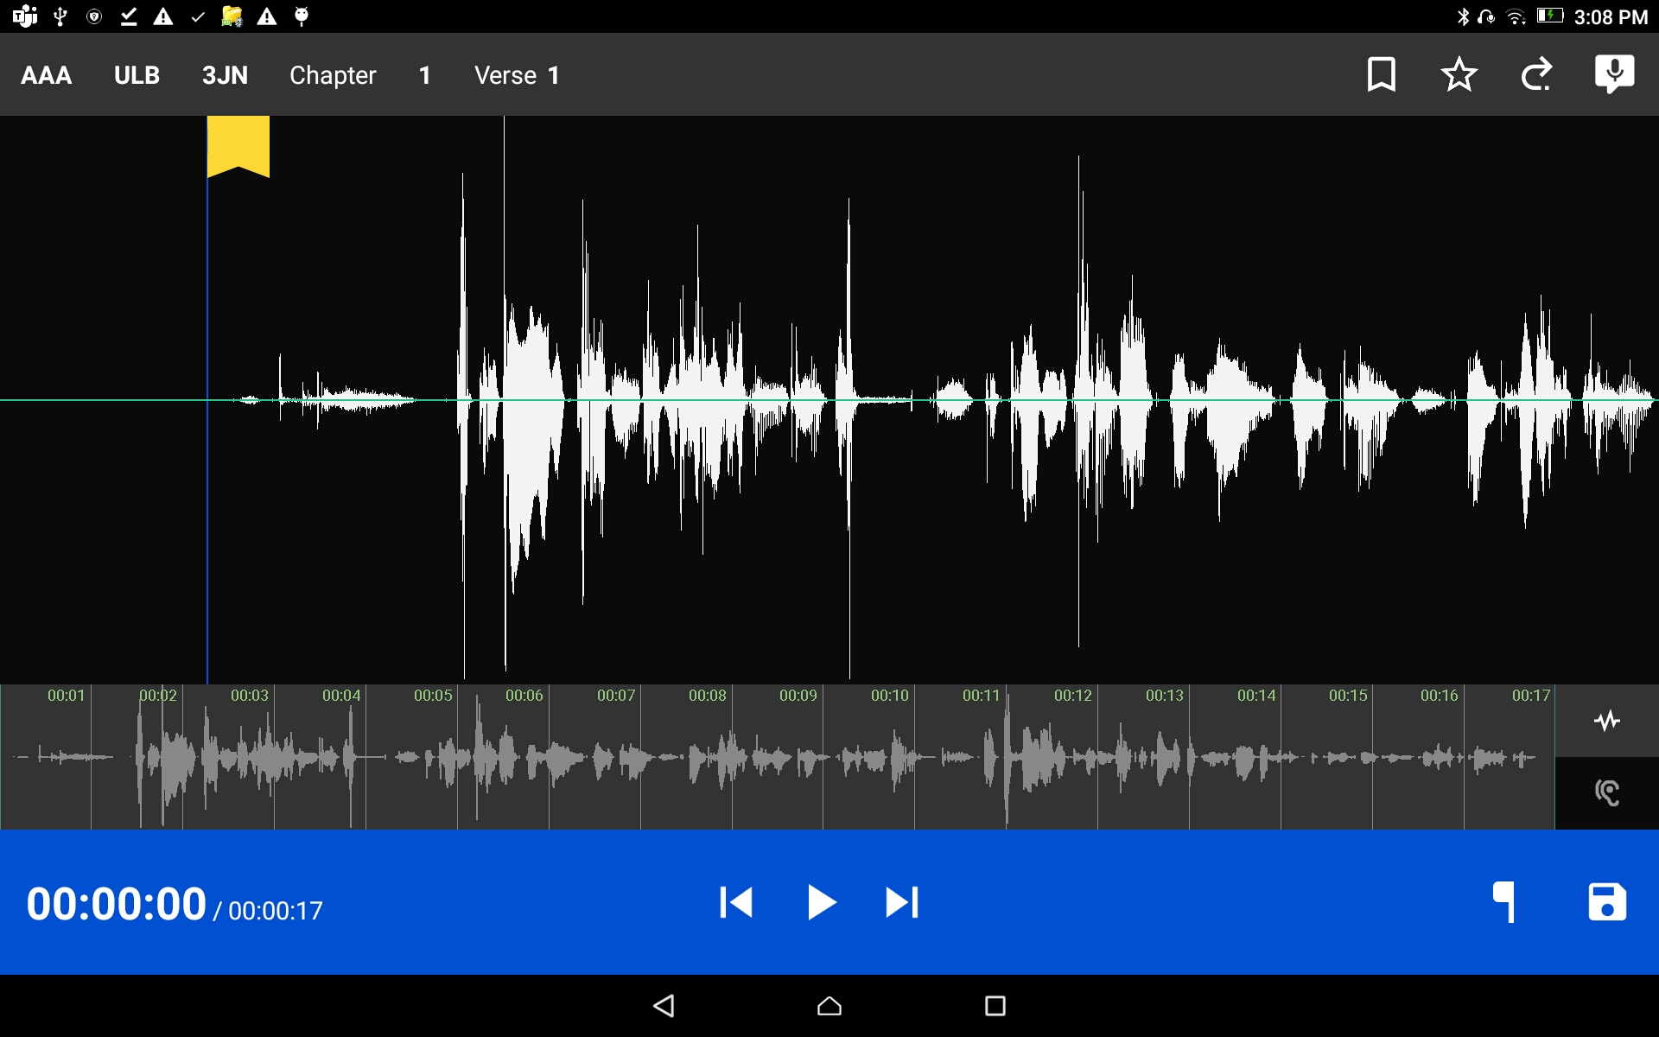

Compare Recording to Source Audio Play the recording
Tap on the wave form icon
and press the play icon.
Listen to the recording.

Slide 5
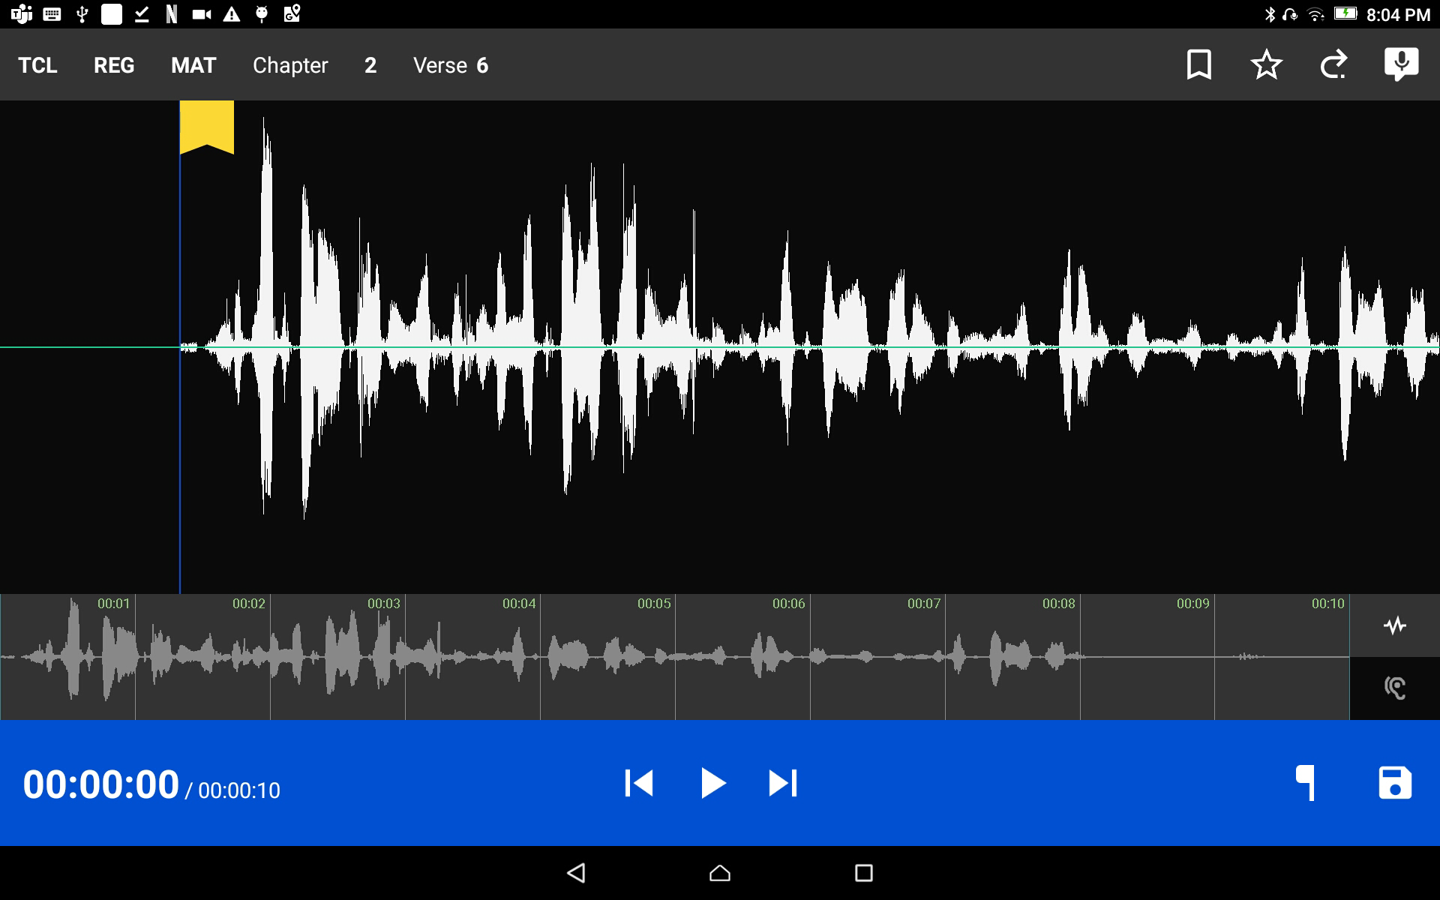



Compare Recording to Source Audio Play the recording
To replay your recording simply tap the play button .
To rewind the recording tap and to fast forward tap .

Slide 6
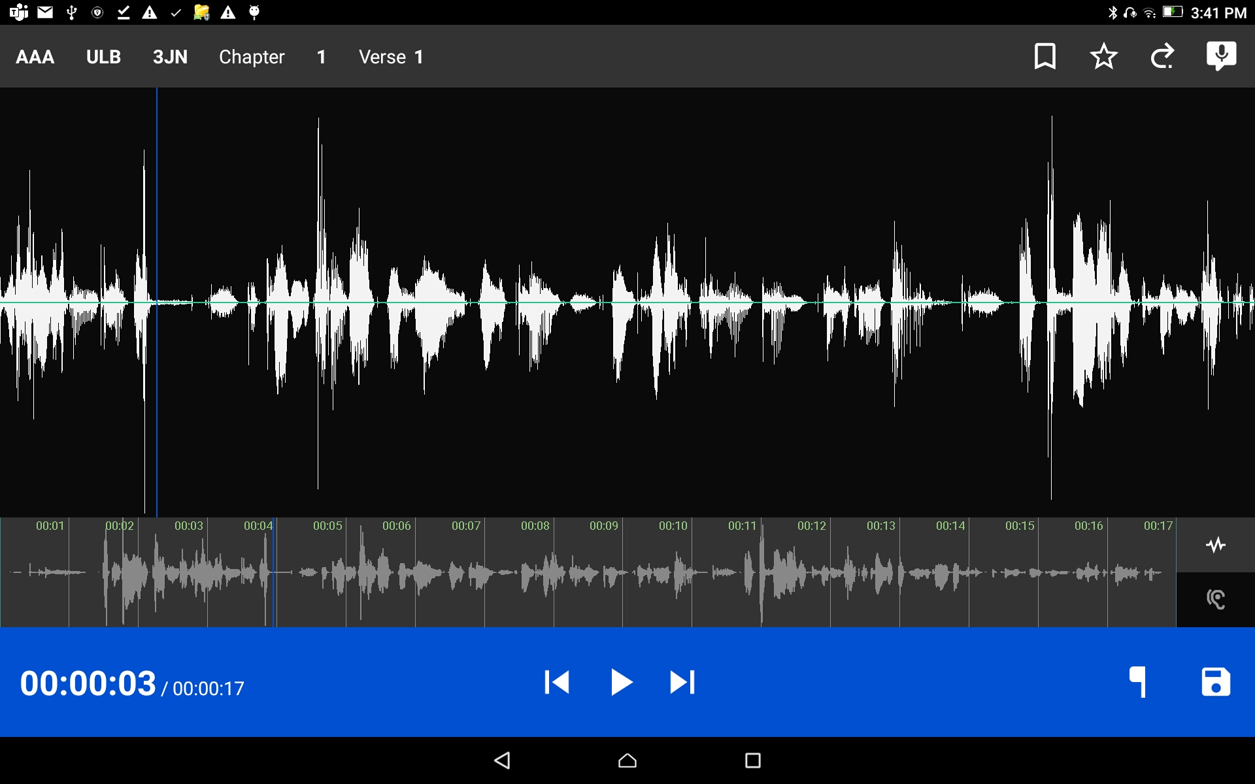
Remove a section of recording
The action of removing a section of a recording is known as a ‘cut.’

Slide 7

Remove a section of recording
Position the audio at the thin blue line for the beginning of the recording to be removed.
Use a finger to do the press-hold-drag action.
Press the button.

Slide 8
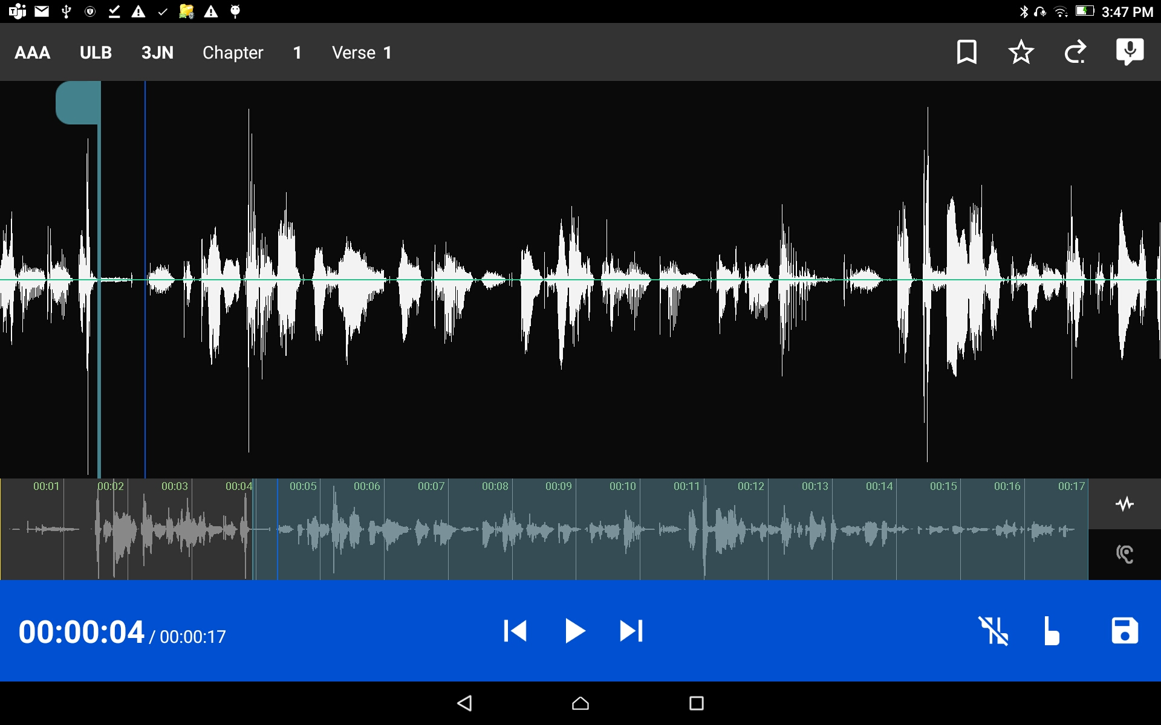


Remove a section of recording
Use a press-hold-drag motion and position the audio at the thin blue line for the end of the recording to be removed.
Press the button.
Tap the
to remove edit markings.

Slide 9
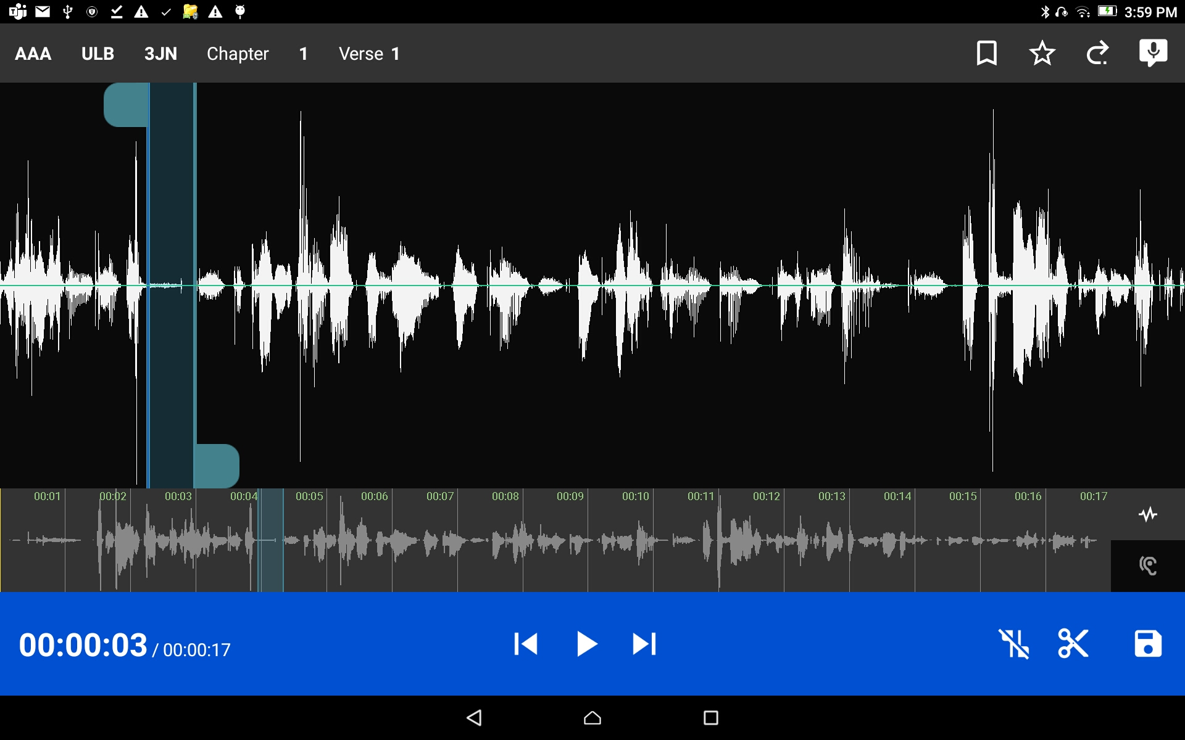

Remove a section of recording
Tap the play icon on the blue bar to listen to the selected audio.
You may use a press-hold-drag motion to move the right blue/green tab to change the amount of audio to remove.

Slide 10

Remove a section of recording
Tap the scissors icon to cut out the marked section.

Slide 11

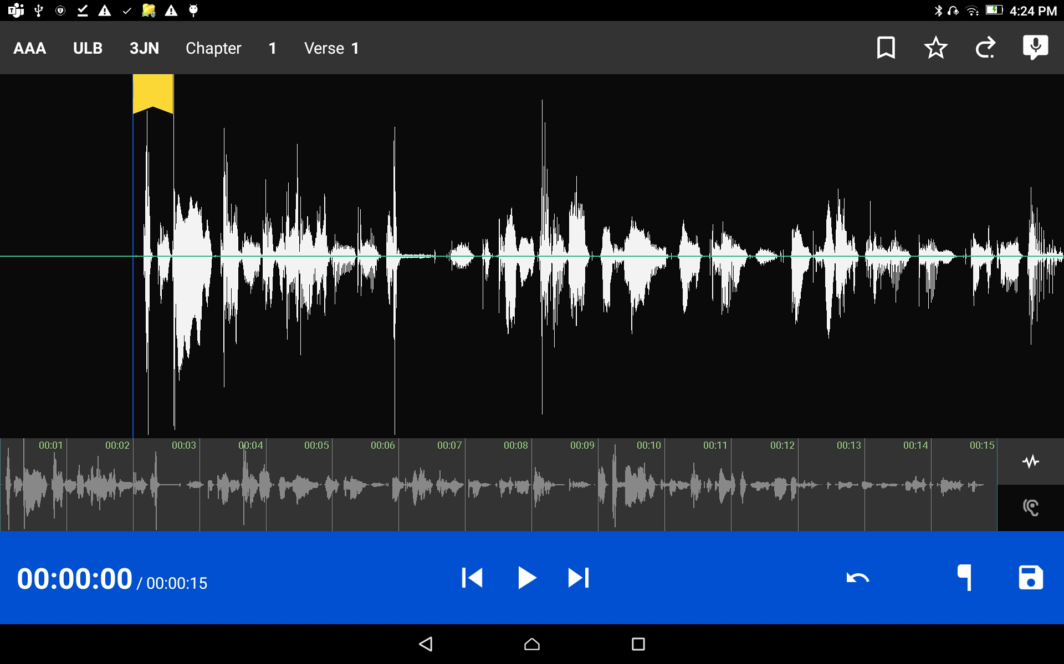

Remove a section of recording
Tap the back arrow icon to undo the cut.
Tap the save icon to save the edits and close the recording window.

Slide 12
Insert a New Section of Recording
Sometimes you may want to insert a missing part into the translation.
?

Slide 13
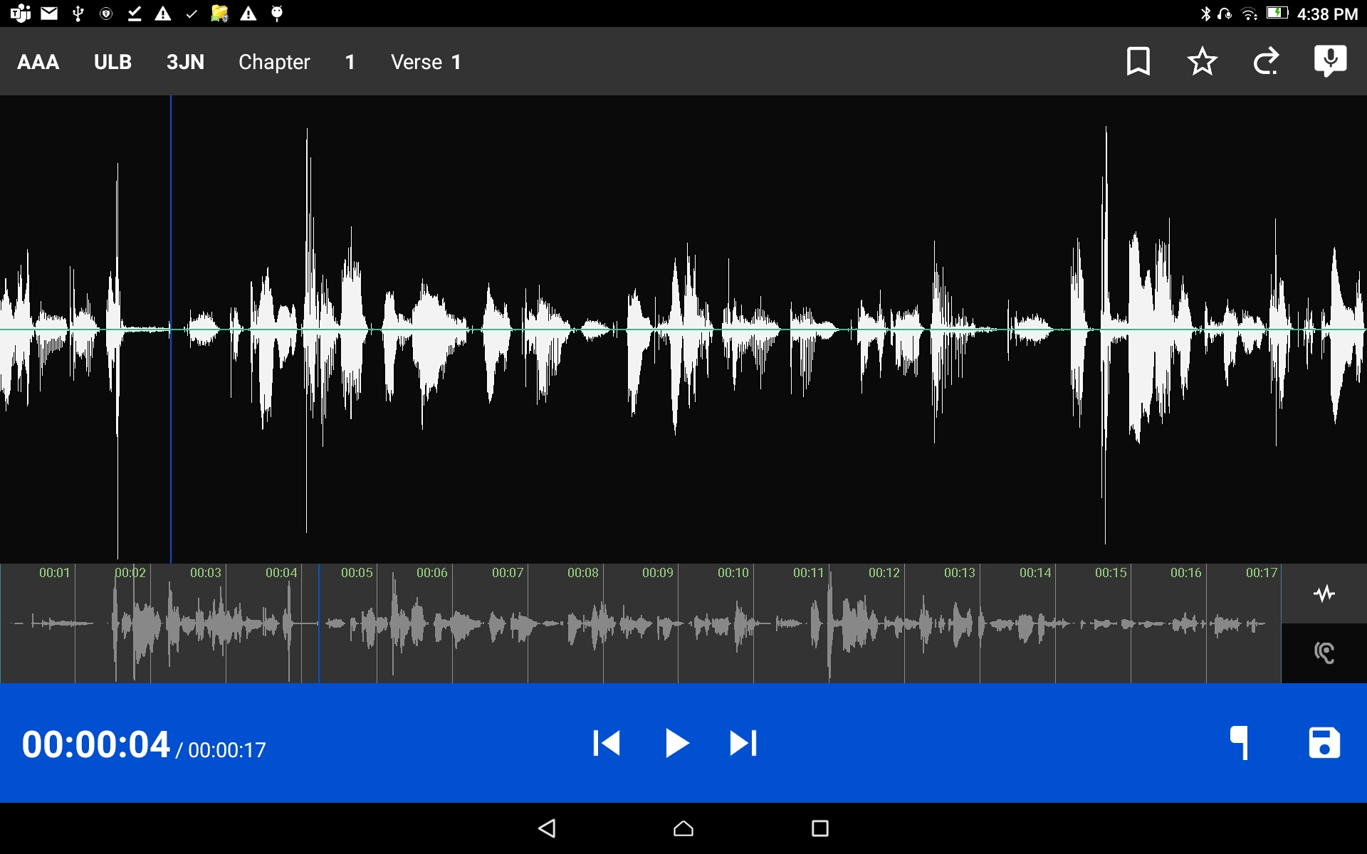

Insert a New Section of Recording
Position the audio at the thin blue line for where the new audio will be added in.
Tap the Microphone icon to start a new recording session.

Slide 14
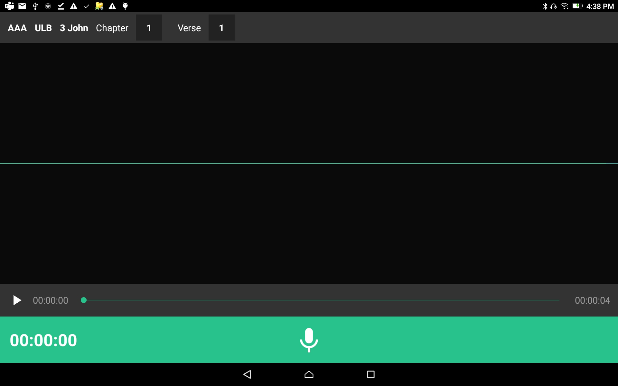
Insert a New Section of Recording
The insert audio recording screen opens.
Tap the Microphone icon on the green bar.

Slide 15
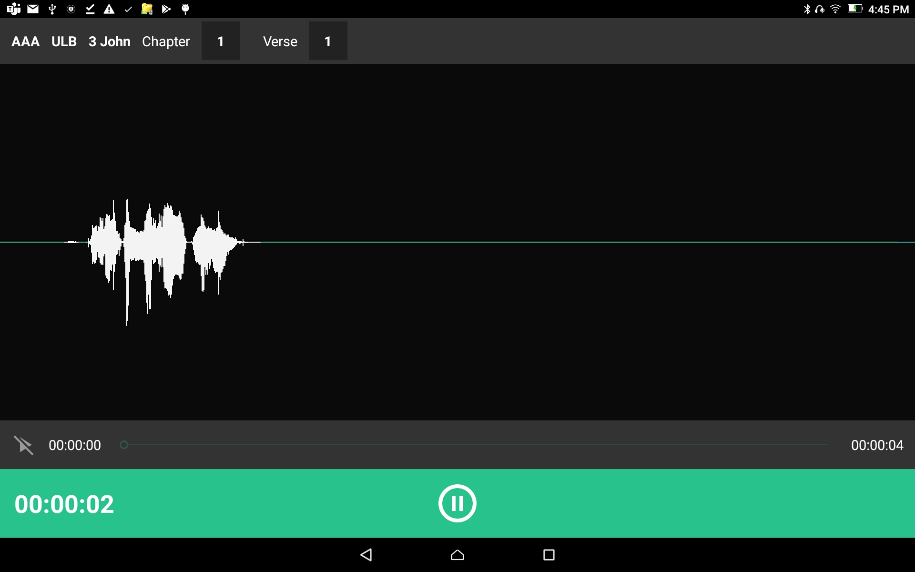
Insert a New Section of Recording
Record the missing section.
Tap the pause icon to stop the recording.

Slide 16
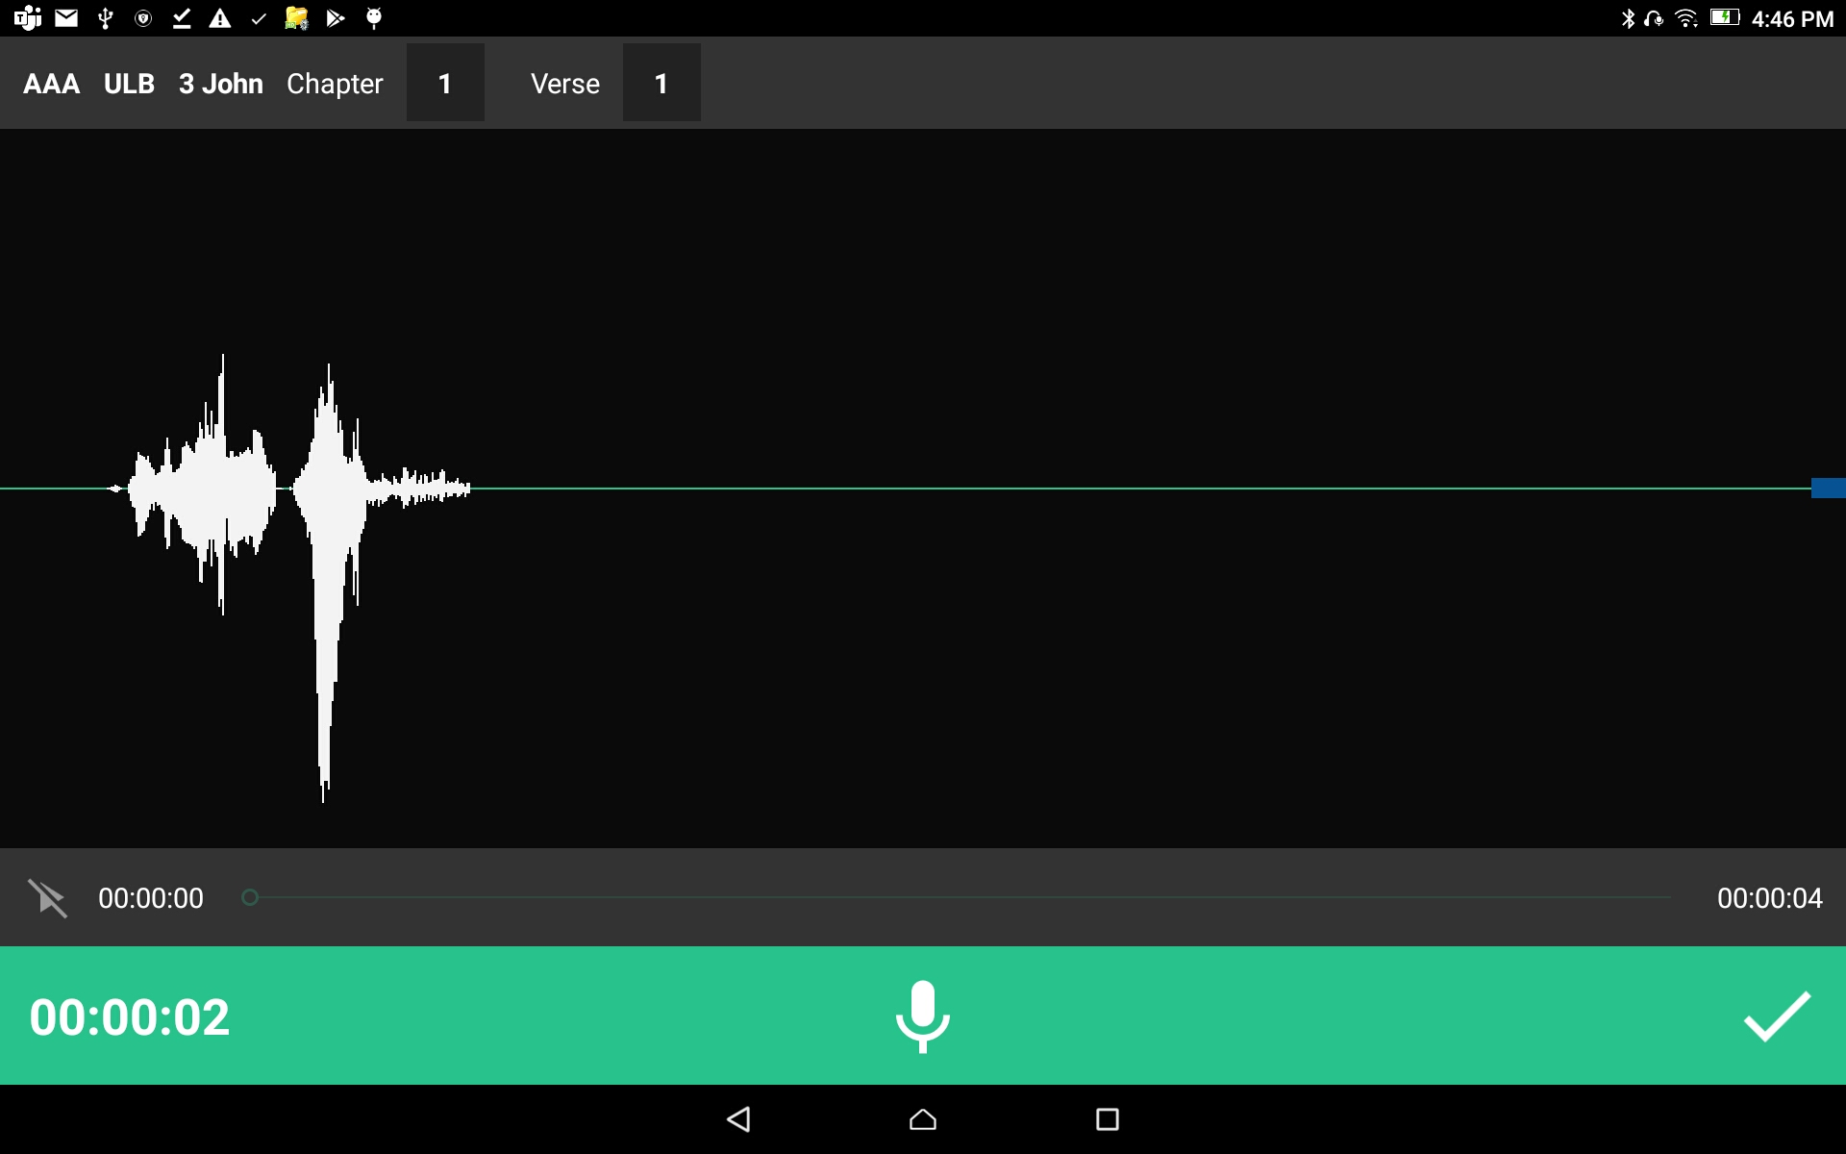
Insert a New Section of Recording
Tap the check mark to save the recording.
Wait while the new section is added into the original recording.

Slide 17
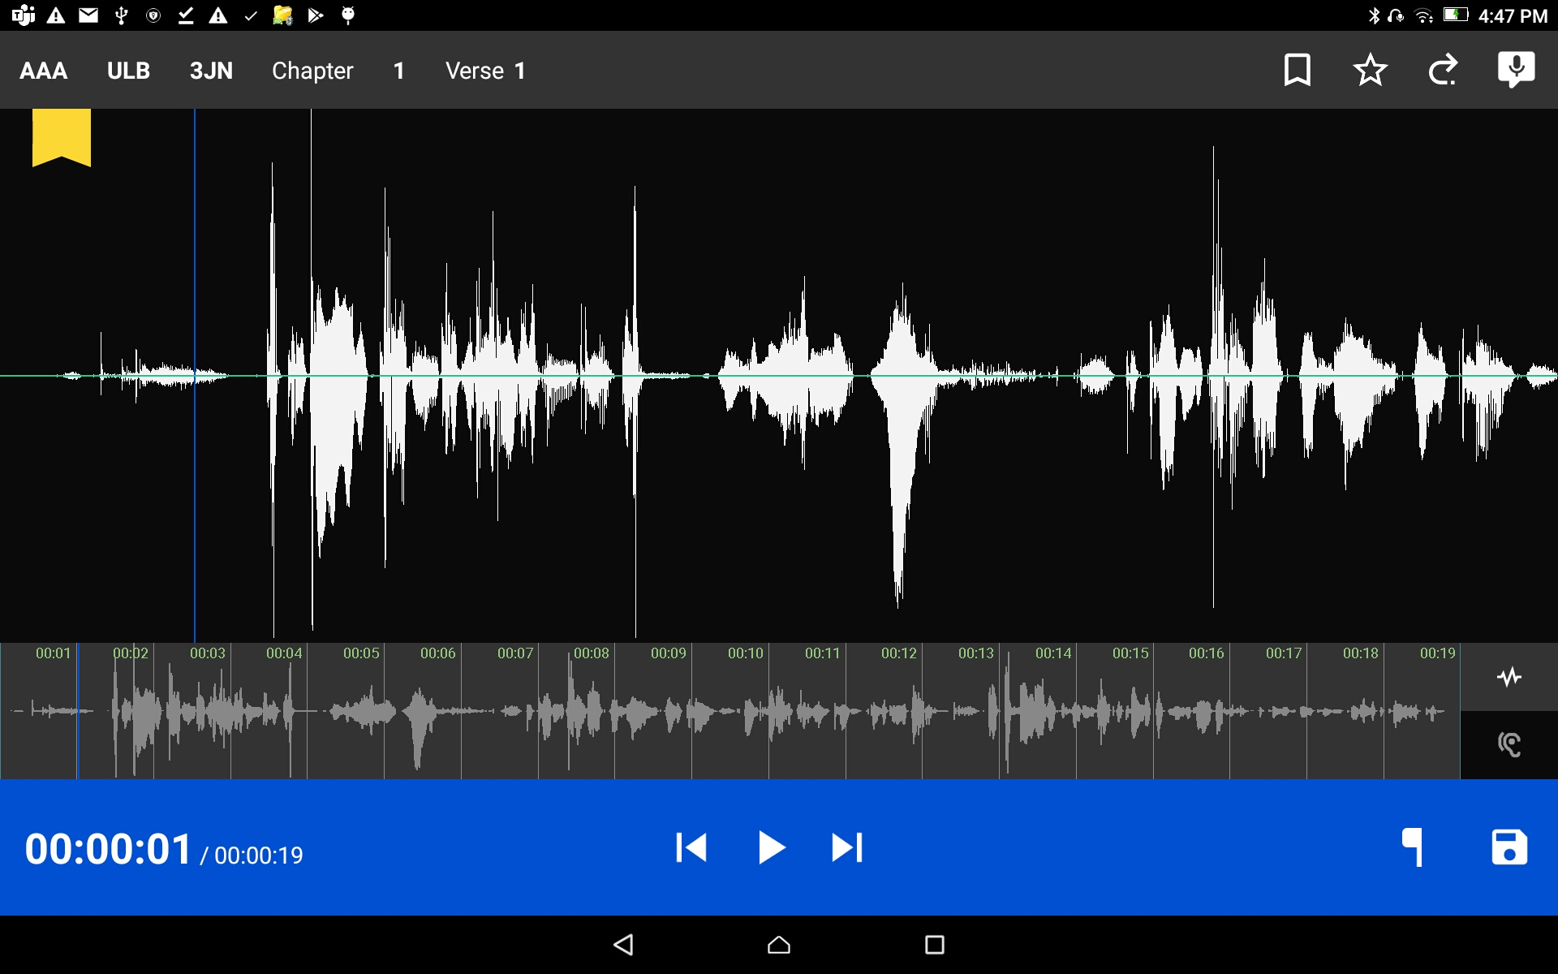
Insert a New Section of Recording
Check that the inserted recording is correct and in the right place.
Find the section that was added and play it in the main recording.

Slide 18
Insert a New Section of Recording
Tap on the save icon to save the edited recording and return back to the Project Management screen.

